Slide 1
What data science is
and how to think in it
What does a data scientist do, and what will you be able to do after 24 sessions?
AI and Data Science Professional | Session 1 of 24 | Module A: Think with data
KLAi Professional Learning | Jotham Martin Wambi
Notes:
Welcome, everyone, and well done for coming after a full day of work. Over twenty-four sessions you will learn how people turn data into decisions. You start in a spreadsheet, which you already know, and you finish with a tested model and a small app that a colleague can open.
Today is the map. We look at what a data scientist does, how a data project is organised, and which free tools we use. Then you open a notebook and run your first line of Python.

Slide 2



Today in one view: what you will leave with
By the end of today you can
Name the four roles on a data team, and the six phases of the CRISP-DM lifecycle from business question to deployment
Tell artificial intelligence, machine learning, deep learning and data science apart by what each one produces
Count the records and variables of a table in Google Sheets, then open Google Colab and run your first cell
Notes:
Here is what you can do by the end of today. You can name the four roles on a data team and the six phases of the CRISP-DM lifecycle, which is the industry reference for how a data project runs. You can tell artificial intelligence, machine learning, deep learning and data science apart by what each one produces.
And you can count the records and variables of a table in Google Sheets and run your first cell in Google Colab. Today is the lightest session of the course, so enjoy it.

Slide 3
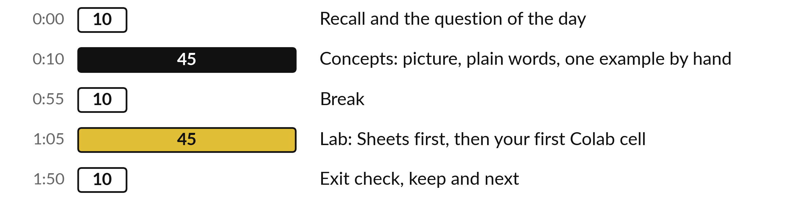
Your two hours: concepts first,
then a Sheets and Colab lab
Ideas with pictures first. Then the sheet and a notebook. Then what you keep.
Notes:
We have two hours. The first ten minutes set the question of the day. Then forty-five minutes of concepts, with no laptops open, so you can watch the pictures and ask questions. After a ten minute break you open the Lakeside Mart workbook in Google Sheets and then a Google Colab notebook, for a forty-five minute lab.
The last ten minutes are an exit check and what you keep. The lab is where the learning sticks, so please protect that time.

Slide 4





Words we use today
Word | What it means
Data science | Using data, tools and careful thinking to answer a question and support a decision. It is a way of working that runs from question to decision.
Machine learning (ML) | A computer finds a rule from examples. A person does not type the rule.
Dataset | A collection of data about one subject, arranged in tables. In Excel words: a workbook in which each tab is one table.
Model | A rule found from data that turns inputs into a prediction or an explanation.
Lifecycle (CRISP-DM) | The phases a data project passes through. CRISP-DM is the industry reference: six phases, from business understanding to deployment.
Notes:
Five words for today. I give the plain meaning of each, and we use every one of them before the end of the session.
Data science. Using data, tools and careful thinking to answer a question and support a decision. It is a way of working that runs from question to decision.
Machine learning (ML). A computer finds a rule from examples. A person does not type the rule.
Dataset. A collection of data about one subject, arranged in tables. In Excel words: a workbook in which each tab is one table.
Model. A rule found from data that turns inputs into a prediction or an explanation.
Lifecycle (CRISP-DM). The phases a data project passes through. CRISP-DM is the industry reference: six phases, from business understanding to deployment.

Slide 5
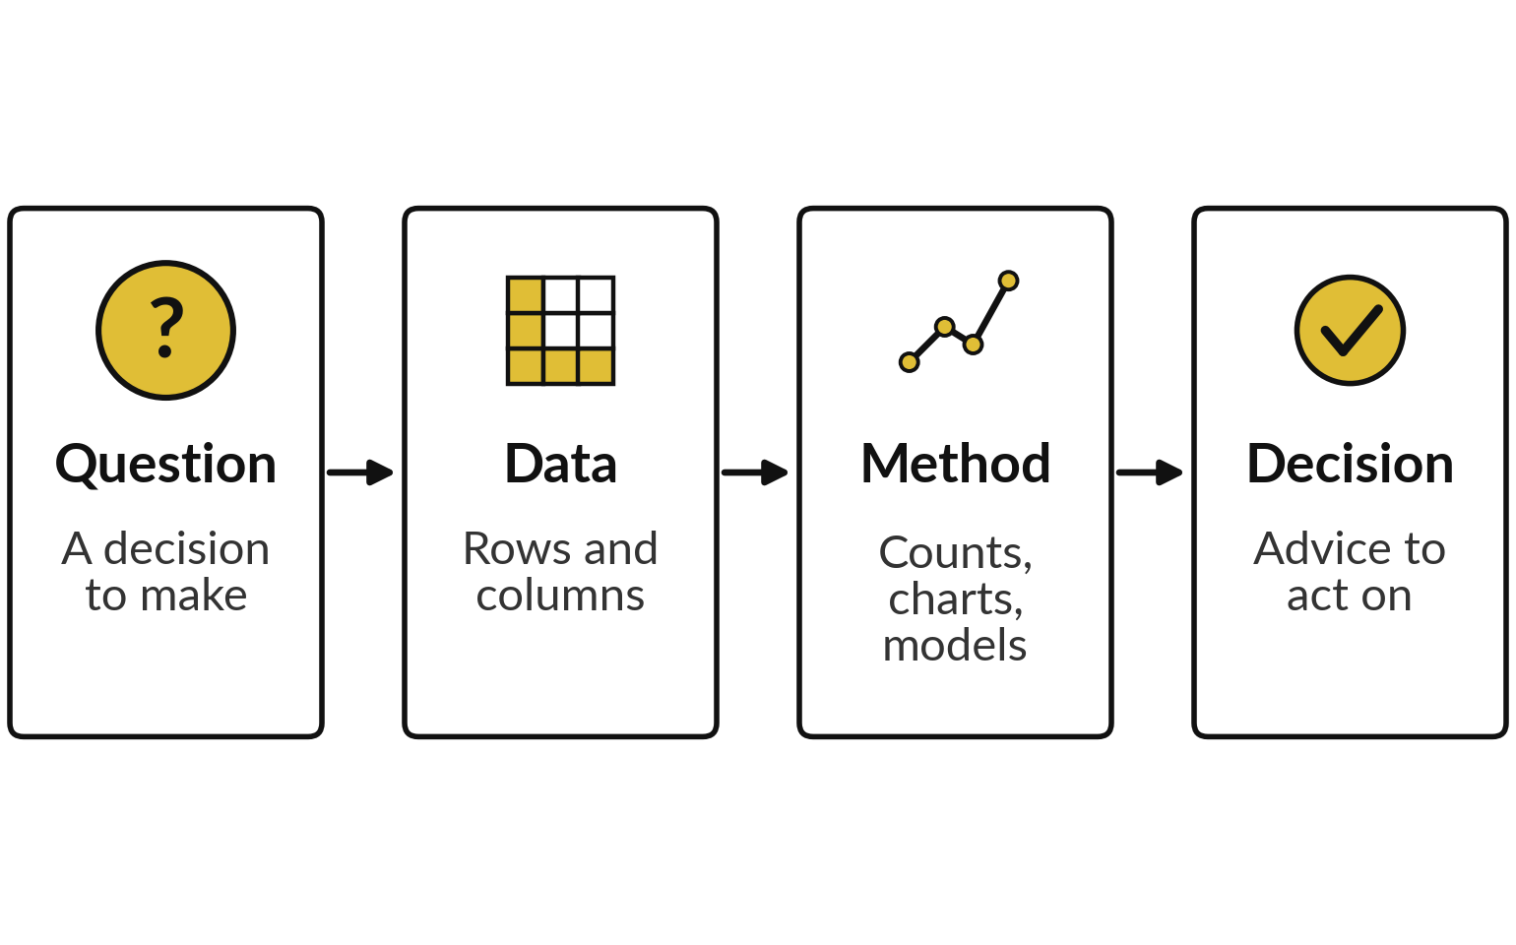
Data science turns a question
and data into a decision
Data science is a way of working: someone asks, data answers, and a person decides.
Dataset: a workbook in which each tab is one table.
Model: a rule found from data. You fit your first model in Session 13.
A chart nobody uses has failed.
Notes:
So what is data science?
My answer is simple. It is a way of working that turns a question and some data into a decision. It starts with a decision that somebody has to make. Then you find the data, which means rows and columns, the same as in your spreadsheets. In Excel words, a dataset is a workbook where each tab is one table.
Then you apply a method. Mostly that is counting, charts and careful comparisons, and sometimes a model, which is a rule found from data. It ends with advice a manager can act on. Which of the four boxes do you think people forget most often?

Slide 6


A business question worth asking
names the decision it feeds
A weak question
A strong question
Tell me about sales.
No decision attached.
No number to find.
Which branch has the lowest median order value this quarter, so it gets next month's support visit?
It names the measure (median order value) and the decision (the support visit).
The Lakeside workbook has the data.
Write the decision first, then the question.
Notes:
Every project starts with a question, and most weak projects start with a weak question. Tell me about sales is weak. It has no decision attached, no number to find, and no sign of when you are done. Which branch has the lowest median order value this quarter, so it gets next month's support visit, is strong.
It names what to measure, which is the median order value. It names the decision it feeds, which is the support visit. And it needs data you can actually get, which is the Lakeside workbook. So write the decision first, then the question. Think of one question from your own work.
Is it weak or strong?

Slide 7
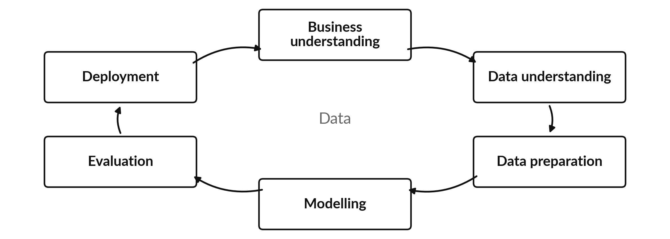
CRISP-DM, the industry reference,
splits a data project into six phases
CRISP-DM: Cross-Industry Standard Process for Data Mining. A later phase can send you back.
Notes:
This circle is the lifecycle, and it has a real name that you will meet in job adverts and textbooks. It is called CRISP-DM, which stands for Cross-Industry Standard Process for Data Mining. It was written down in the late 1990s and many teams still use it. It has six phases.
Business understanding, data understanding, data preparation, modelling, evaluation and deployment. Data sits in the middle because every phase touches it. The arrows go round, but you also go back. If evaluation shows a problem, you return to an earlier phase. Which phase do you expect to take the most time?

Slide 8






Each CRISP-DM phase answers a plain
question, and this course covers all six
CRISP-DM phase | The plain question | Where in this course
Business understanding | What decision are we helping with? | Session 1 and the course project, Session 24
Data understanding | What does each table and variable mean? | Sessions 2 to 4 and Session 11
Data preparation | How do we clean and join the data? | Module B, with the cleaning milestone in Session 8
Modelling | Which rule fits the data? | Sessions 13 to 22
Evaluation | Is the result good enough and fair? | Inside every modelling session and Session 19
Deployment | How do other people use it? | Session 23 (a small app) and Session 24
Many teams add a seventh step after deployment: monitor, which means check later that it still works.
Notes:
Here is each phase with the plain question it answers, and where we do it in this course. Business understanding asks what decision we are helping with. Data understanding asks what each table and variable means. Data preparation is cleaning and joining. Modelling asks which rule fits the data.
Evaluation asks whether the result is good enough and fair. Deployment asks how other people use it. Many teams add a seventh step, monitoring, where you check later that it still works. The session numbers are the plan today and may shift a little. Which phase is the first one you would hand to a colleague?

Slide 9




One Lakeside question
walks through all six phases
CRISP-DM phase | The Lakeside example
Business understanding | Decide which branch gets next month's promotion budget.
Data understanding | The orders tab has 2,000 records. The branches tab has 8 records.
Data preparation | 580 orders have a blank customer_id. They are walk-in shoppers, so keep them.
Modelling | A pivot table of orders and total sales for each branch. A predictive model comes in Module D.
Evaluation | Jinja leads on the mean order, 71,914 UGX. One order of 1,935,520 UGX adds about 7,300 UGX to that mean, but Jinja still leads without it. Check the median and the count too.
Deployment | One page for the manager that shows the count of orders behind each figure.
Notes:
Let us walk one real question through the six phases. The question: which branch gets next month's promotion budget?
Data understanding: the orders tab has 2,000 records and branches has 8. Data preparation: 580 orders have a blank customer id. They are walk-in shoppers, so we keep them. Modelling: a pivot table is enough here. Evaluation matters most. Jinja leads on the mean order, about 71,914 shillings, but one single order of 1,935,520 shillings adds about 7,300 shillings to it.
Jinja still leads without that order, so we check the median and the count before we decide. And deployment is one page for the manager. Would you have caught that large order?

Slide 10



Thinking in data means four habits, and
you practise each one in this course
Before you touch a number, ask these four things.
What decision is this for?
What does one record stand for?
Where did the data come from, and how many records are there?
Did I calculate this number, or did someone tell me?
Notes:
Beyond the lifecycle, here are four habits that mark someone who thinks in data. First, what decision is this for?
Second, what does one record stand for?
Is each row an order, a product on an order, or a customer?
Third, where did the data come from, and how many records are there?
A figure from twenty records means something different from a figure from twenty thousand. Fourth, did I calculate this number, or did someone tell me?
Session 2 teaches the second habit properly. Which of the four is hardest for you at work?

Slide 11
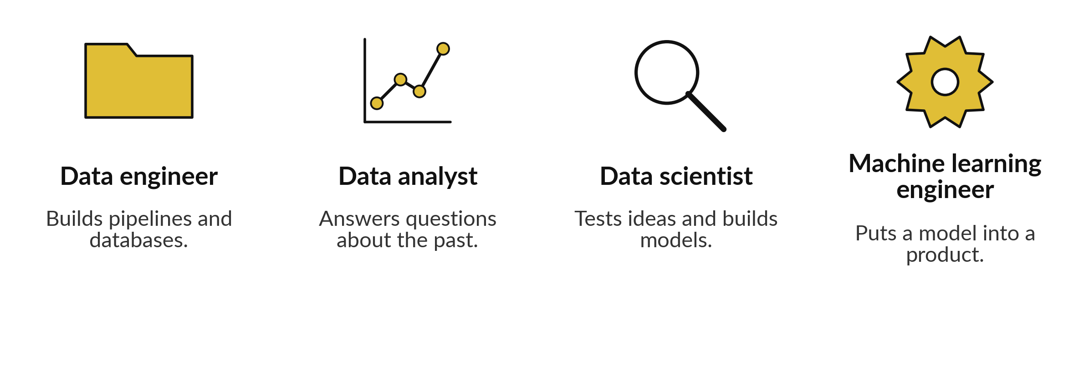
Four roles share the work on a data team
One person often does several jobs. You practise the analyst and scientist jobs.
Notes:
Data work is a team sport, and four job titles come up again and again. The data engineer builds the pipelines that move data and keeps the databases running. The data analyst answers questions about the past with tables, charts and dashboards. The data scientist tests ideas and builds models that explain or predict.
And the machine learning engineer puts a model into a product and keeps it running. In a small organisation in Uganda, one person often does several of these jobs. In this course you practise the analyst and the data scientist jobs. Which of the four is closest to your job today?

Slide 12
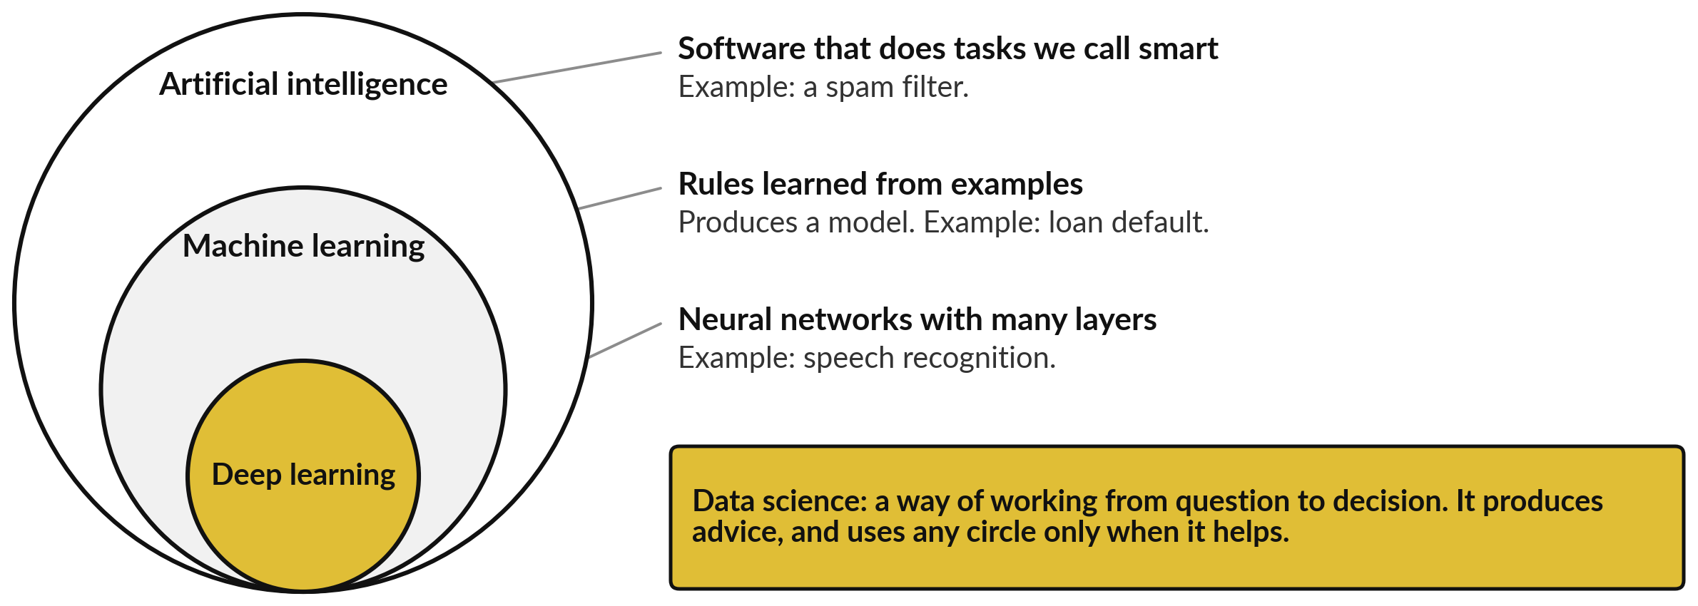
Artificial intelligence, machine learning,
deep learning and data science differ
Data science is the way of working, and often needs no machine learning.
Notes:
You hear three big words in the news. Artificial intelligence is the biggest circle. It means any software that does a task we would call smart, like a spam filter. Machine learning sits inside it. These programs find rules from examples, and the result is a model. Deep learning is a smaller circle inside machine learning.
It uses neural networks with many layers, and it powers speech recognition. Data science is different. It is a way of working from question to decision, and it uses machine learning only when that helps. Often a pivot table is enough. Which circle did you think data science was?

Slide 13


A formula is a rule you write; a
model is a rule found from data
Rule written by a person
Rule found from examples
Revenue = quantity × price × (1 − discount).
It holds on all 6,590 order lines.
Nile Microfinance: 8,000 loans, 1,004 defaulted.
An algorithm finds which loan details go with default.
A model is a rule found from data.
Notes:
Here is the difference between a formula and a model. On the left, a rule that a person wrote. Revenue of an order line is quantity times unit price times one minus the discount. We checked, and it holds on all 6,590 order lines in the workbook. On the right, a rule found from examples.
In the fictional Nile Microfinance file, 8,000 past loans are recorded and 1,004 of them defaulted. A learning algorithm looks at the loan details and finds which ones go with default. Nobody typed that rule. That is machine learning, and you fit your first model in Session 13 (regression) and build machine learning models from Session 14.
Can you think of a rule in your work that nobody could write by hand?

Slide 14
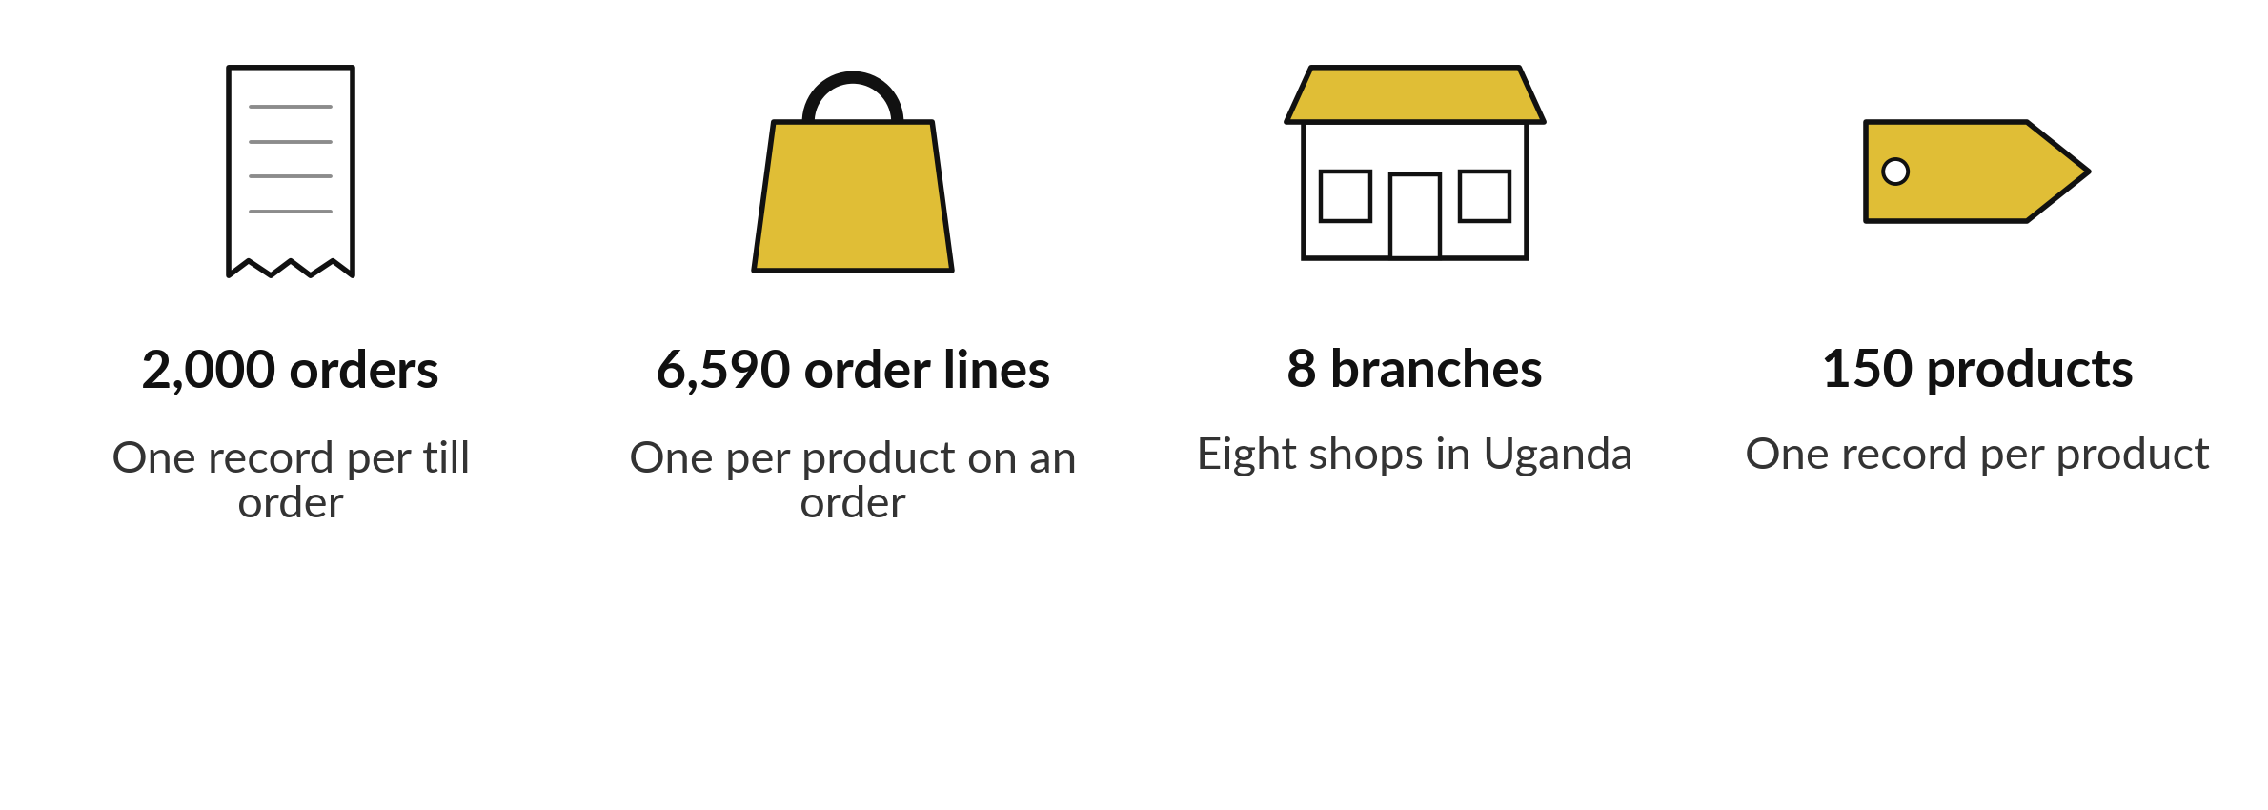
Lakeside Mart is the real
data for the whole course
Fictional, generated data. A sample of a 30,229-order file.
Notes:
Now the data we use all course. Lakeside Mart is a fictional chain of eight mini-markets in Uganda. The workbook has 7 tabs: six data tabs and a READ ME. The orders tab has 2,000 records. Each record is one till order. The order lines tab has 6,590 records, one for each product on an order.
There are 8 branches and 150 products. The workbook is a sample of 2,000 orders from a full file of 30,229. Everything is generated, so no real person or company appears. In Session 2 we look at every tab closely. Which table would you open first?

Slide 15
A chat assistant can state a
figure that nobody calculated
Unchecked
Checked
You ask for the share of orders paid by Mobile money.
It answers with a clean percentage.
It predicts likely words and may not calculate.
One COUNTIF formula in Sheets gives it.
976 of 2,000 orders: 48.8 percent.
Write the source beside the figure.
Recompute every number you did not calculate yourself.
Notes:
This habit will protect your reputation. You ask a chat assistant what share of orders is paid by mobile money. It answers with a clean percentage in a friendly tone. An assistant predicts likely words, so it can state a figure that nobody calculated. Nothing in its tone tells you which figures are real.
The check takes one formula in Sheets: count the orders paid by mobile money and divide by all orders. The answer is 976 out of 2,000, which is 48.8 percent. Write the source beside the figure. A free assistant is welcome as a helper in this course, but never as the source of a number.
Have you ever pasted a number you did not check?

Slide 16




Every tool in this course is
free for you and for the tutor
Tool | What you use it for | Cost
Google Colab | Python notebooks in your browser | Free with a Google account
Google Sheets (or Excel, LibreOffice) | Tables, pivot tables and charts | Free, or what you own
pandas, NumPy, scikit-learn, matplotlib | Data work, models and charts in Python | Free, open source
SQLite | Questions to a database with SQL | Free, inside Python
GitHub | Save and share your work | Free account
Streamlit Community Cloud | A small web app for your model | Free for public apps
At the time of writing these are free. Free plans can change, so check current terms before you rely on one.
Notes:
Every tool in this course is free for you and for me. Google Colab runs Python notebooks in your browser, so there is nothing to install. Google Sheets, Excel or LibreOffice give you tables, pivot tables and charts. The Python libraries pandas, NumPy, scikit-learn and matplotlib do the data work, the models and the charts.
SQLite lets you ask questions of a database with SQL. GitHub saves and shares your work, and Streamlit Community Cloud turns a model into a small web app. At the time of writing all of these are free, but free plans change, so check the current terms. Which of these have you already used?

Slide 17






The course is six modules, and
each builds on the one before
Module | Sessions | What you do
A Think with data | 1 to 4 | Sheets, no code
B Python for data | 5 to 9 | Python, pandas, first SQL
C Analyse and explain | 10 to 13 | SQL, charts, inference, regression
D Machine learning | 14 to 19 | Build, test and judge models
E Neural networks and text | 20 to 22 | Networks, text, embeddings
F Ship it and present | 23 and 24 | A small app, then your course project
Project milestones are in Sessions 8, 13, 19 and 24. Every session has a concepts half, then a lab where you work.
Notes:
Here is the path for the whole course. Module A, today and the next three sessions, is thinking with data in Sheets, with no code. Module B teaches Python for data. Module C is analysing and explaining: SQL, charts, inference and regression. Module D is machine learning, where you build, test and judge models.
Module E covers neural networks and text. Module F is shipping and presenting: a small app, then your course project. Sessions 8, 13, 19 and 24 have a project milestone, a practical piece of work that you show me and get feedback on. Nothing in this course is scored, and you keep everything you build.
Forty-eight hours is short, so we choose the working core of the field. Which module are you most looking forward to?

Slide 18
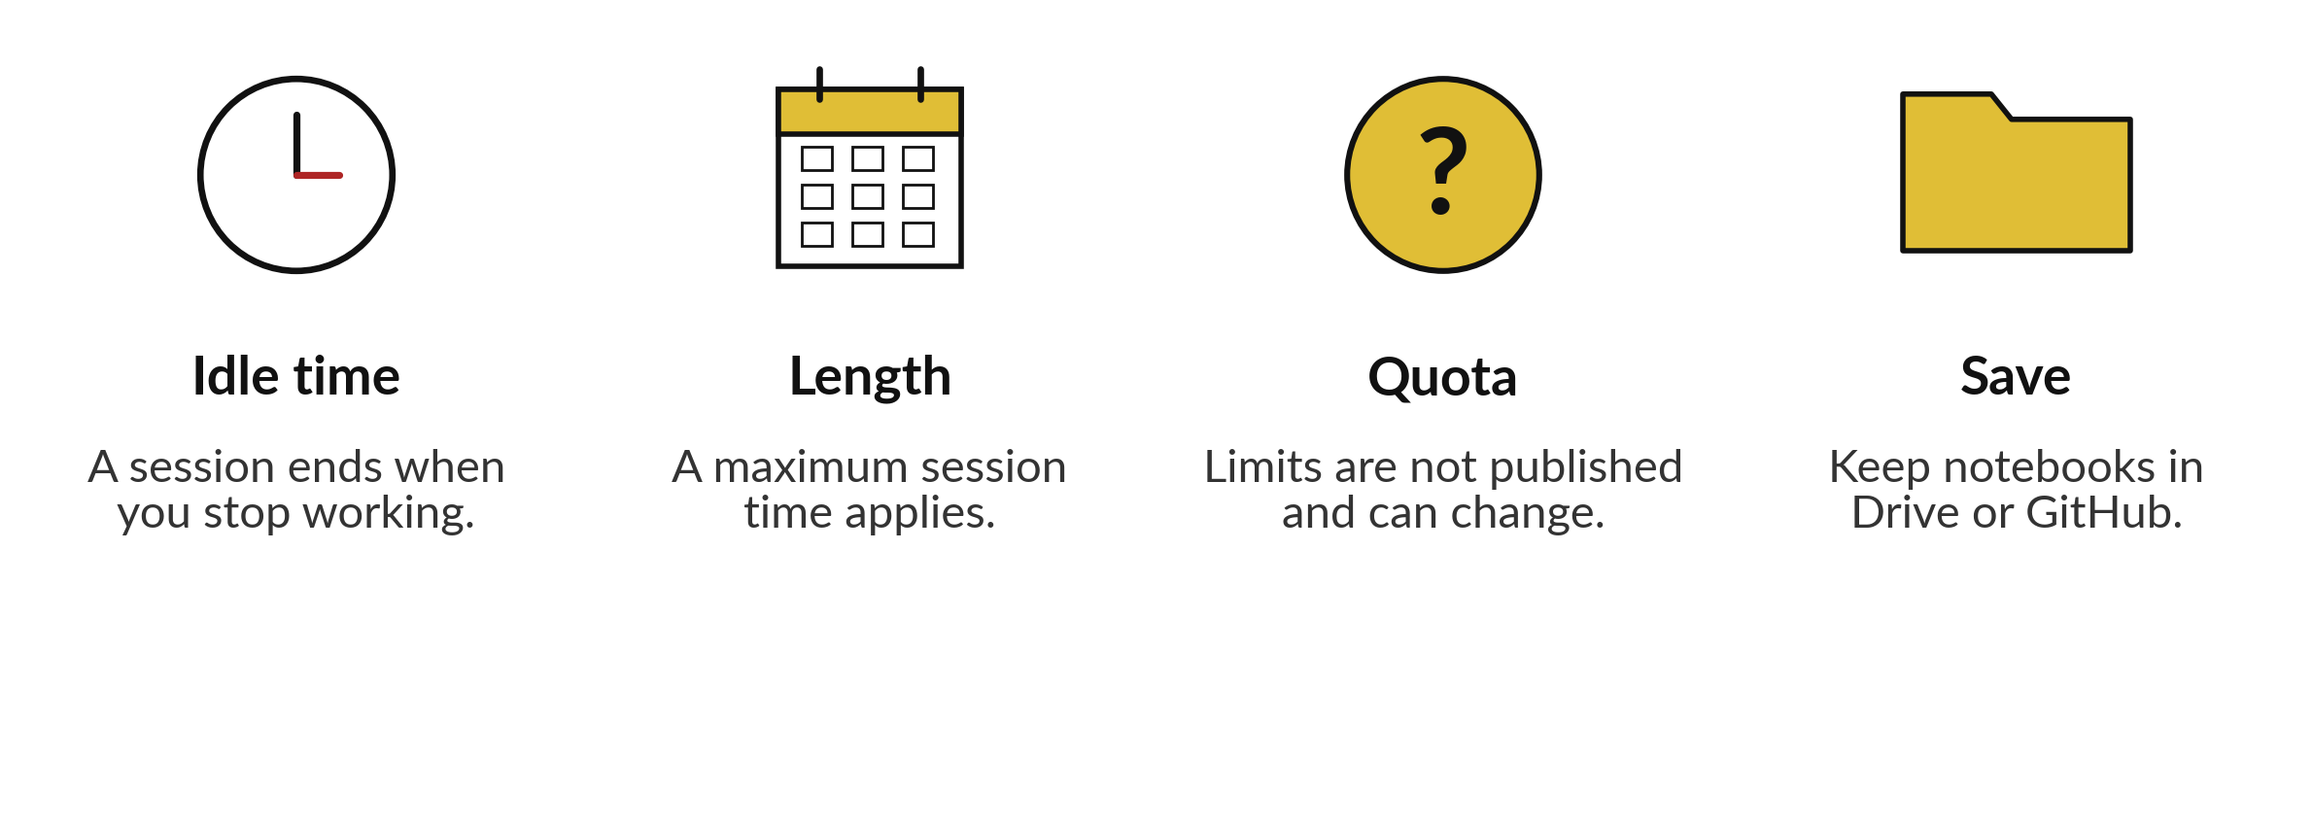
Colab is free, with limits to plan for
My understanding at the time of writing. Check current limits.
Notes:
Colab is free, and free comes with limits. A free session ends after you stop working for a while, which is the idle time. A session also ends after a maximum length. Reports mention about twelve hours, but Google does not publish exact limits, and they can change.
So plan for it from day one. Save your notebooks in Google Drive or on GitHub, and run the cells again from the top when a session ends. That is my understanding at the time of writing, so check the current limits before you rely on a long run.
Where will you keep your notebooks?

Slide 19
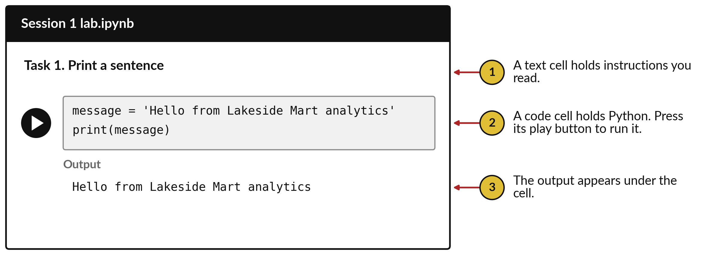
A notebook is made of cells: text
cells you read and code cells you run
Python is the programming language. A cell is one box of code. Run it, read it, change it, save it.
Notes:
This is what a notebook looks like. It is a document made of cells. A text cell, marked one, holds instructions that you read. A code cell, marked two, holds Python, and you run it with the play button beside it. The output, marked three, appears under the cell.
In this picture the code stores a sentence in a name called message and then prints it, and the sentence appears. We ran this exact code to get that output. You can edit any cell, run it again, and see the output change. That is the whole loop.
Does anything on this picture look unfamiliar?

Slide 20




Where you will use this at work: frame
the question before you open the data
Your job | The question you start from | What today lets you do
Credit officer at a bank in Kampala | Which loan applications are likely to go unpaid? | Write the decision first, then find the loans table.
Monitoring and evaluation officer at an NGO | Did the training raise farmers' yields? | Name the data you need before you promise a report.
Operations manager at a retail chain | Which branch has the lowest median order value, so it gets next month's support visit? | Check any figure an assistant gives you against your own workbook.
Health records officer at a district office | Which months do clinics run short of drugs? | Use the six phases as a checklist for a monthly report.
Notes:
Where will you use this on Monday?
Four examples. A credit officer at a bank in Kampala starts from the question: which loan applications are likely to go unpaid?
Writing the decision first points to the loans table. A monitoring and evaluation officer at an NGO asks whether training raised farmers' yields, and names the data needed before promising a report. An operations manager at a retail chain asks which branch has the lowest median order value, so it gets the support visit, and checks any figure an assistant gives against the workbook.
A health records officer uses the six phases as a checklist for a monthly report. Which of these is closest to your job?

Slide 21
Read the recipe before the lab:
four lines make your first cell
In plain words
message = 'Hello from Lakeside Mart analytics'
print(message)
total = 4500 + 2800
print(total)
Line 1 stores a sentence in a name called message.
Line 2 prints it under the cell.
Line 3 adds two illustrative prices in UGX, rice 4,500 and sugar 2,800, and stores the sum in total.
Line 4 prints 7300.
Hello from Lakeside Mart analytics
7300
Notes:
Before the lab, read the recipe. This is real Python, and we ran it. Line one stores a sentence in a name called message. Line two prints it. Line three adds two illustrative prices, 4,500 shillings for rice and 2,800 for sugar, and stores the result in a name called total.
Line four prints it, and the answer is 7300. In Python a name that holds a value is called a variable. This is a second meaning of the word: in a table, a variable is a column. Context tells you which. In the lab you write these lines yourself, run them with the play button, and read what comes out.
Then you change one thing and run it again. What do you expect if you change the sentence?

Slide 22
Part 2: the Sheets and Colab lab
Close the slides. Open the sheet.
Notes:
That is the end of the ideas. Everything you need is on the slides you have just seen. First, open the Lakeside Mart workbook in Google Sheets, or in Excel if you prefer. The file is called lakeside for sheets. You count the records and variables of each tab, and recompute one share.
After that you open the Session 1 notebook in Google Colab and run your first cells. In every task, predict the answer first, then run it, then read what you see.

Slide 23
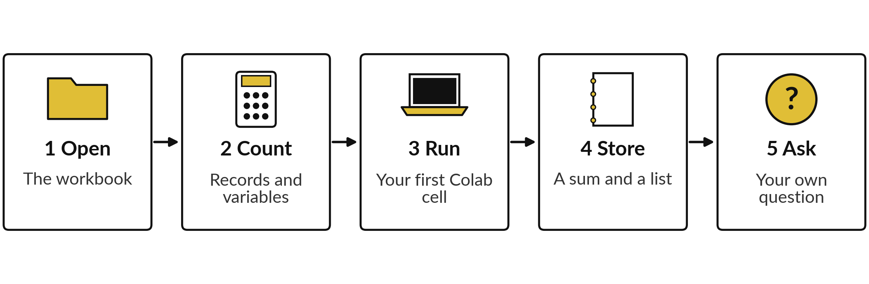
The lab has five steps: two
in Sheets and three in Colab
About 45 minutes. For each task, predict first, then run it, then read the answer. Save your notebook to your Drive at the end.
Notes:
Here is the map of the lab. Step one, open the workbook and find its tabs. Step two, count the records and variables of each tab, and recompute the mobile money share. Step three, open the notebook in Colab and run your first cell. Step four, store a sum and a list, and load the full orders file to count its records.
Step five, write your own business question with the decision it would feed. In every task, predict first. Please do not skip the predictions, because they are where you learn the most.

Slide 24






Check your numbers before you move on
What you compute | You should get
Tabs in the workbook, with READ ME | 7
Records in orders, and in order_lines | 2,000 and 6,590
Variables in orders, and in order_lines | 7 and 7
Blank customer_id in orders | 580
Share of orders paid by Mobile money | 976 of 2,000, which is 48.8 percent
Output of your first cell | Hello from Lakeside Mart analytics
The sum of 4500 and 2800 | 7300
Records in the full orders.csv file | 30,229
If your number differs, find the task that went wrong. Do not change a number to match.
Notes:
Use this table as your own self-check. Nobody marks it. If your numbers match, carry on. If one does not, stop and call me, because later tasks use the earlier ones. The most common cause in Sheets is a range that includes the header row, which makes every count one too big.
In Colab it is a cell run out of order. Do not change a number to make it match. Find out why it is different. What does it mean if your count of records in orders comes out as two thousand and one?

Slide 25


Five likely mistakes in the lab and how to fix them
What you see | What it means | What to do
A count of 2,001 where you expected 2,000 | The range includes the header cell in row 1. | Start the range in row 2: A2:A2001.
NameError: name 'message' is not defined | You ran a cell before the cell that creates the name. | Run the cells from the top, one after the other.
SyntaxError: unterminated string | A quote mark is missing at one end of the text. | Put the same quote mark at both ends: 'text'.
FileNotFoundError: orders.csv | The setup cell has not run, or data.zip was not chosen. | Run the setup cell and choose data.zip.
Runtime disconnected | A free session timed out. | Reconnect, run from the top, and save a copy to Drive.
Notes:
Five messages you may meet. A count that is one too big means your range includes the header row. A NameError means you ran a cell before the cell that creates the name, so run from the top. A SyntaxError about a string means a quote mark is missing at one end of the text.
A FileNotFoundError for orders dot csv means the setup cell has not run, or you did not choose the data zip file. And a disconnected runtime means the free session timed out, so reconnect and run again. Read the message first. It usually tells you the answer.

Slide 26


Exit check: three questions, then
compare with the short answers
Question | Short answer
In CRISP-DM, which phase comes straight after business understanding, and what do you do in it? | Data understanding: find the tables that could answer the question and check what they mean.
In Excel words, what is a dataset, and how does a model differ from a formula? | A dataset is a workbook in which each tab is one table. A model is a rule found from data, where a formula is typed by a person.
An assistant gives you the share of orders paid by Mobile money. What do you do before you report it? | Recompute it from your own data: 48.8 percent, 976 of 2,000. Write the source beside it.
Notes:
Last, the exit check. Three questions. Write your answers in your notes before you look at mine. One, in CRISP-DM, which phase comes straight after business understanding, and what do you do in it?
Two, in Excel words, what is a dataset, and how does a model differ from a formula?
Three, an assistant gives you a share of orders paid by Mobile money. What do you do before you report it?
The short answers are on the slide. These three are also the warm-up questions in Session 2. If one surprised you, look at that slide again tonight.

Slide 27
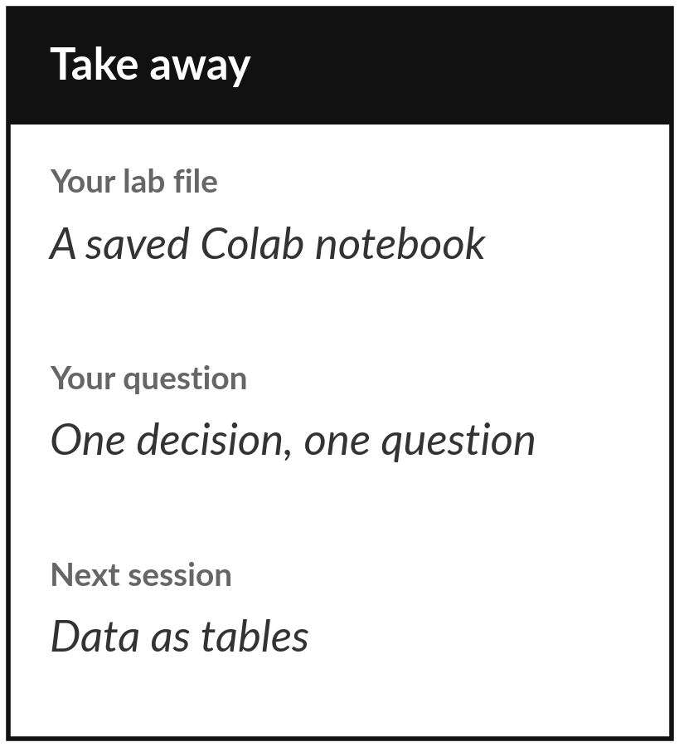
Save your notebook and your question,
then bring one question to Session 2
What you keep from today
Keep your saved Session 1 notebook in Google Drive, and your one-sentence business question with the decision it would feed.
Our question today
What does a data scientist do, and what will you be able to do after 24 sessions?
Next session
Session 2: Data as tables: records, variables and keys. We open every tab of the Lakeside workbook and learn how the tables connect.
Notes:
Before you go, make sure your notebook is saved to your own Google Drive, and that you have written down your business question with the decision it would feed. Those two things are your keepsake from today. A good question names something to measure and a decision that someone must make.
Next session we look closely at the thing every later session depends on, the table. If anything was unclear today, write the question down and bring it.
We began with this question: What does a data scientist do, and what will you be able to do after 24 sessions? Before you go, say in one sentence what you can now say about it.

